Slide 1
Movie Recommendation System
Sk Hasimuddin
19370049
Under guidance of
Dr. R. subramanian

Slide 2



What is a Recommender System?
Recommender system refers to a system that helps users discover new products and services that are relevant to him.
Example:
Video-on-demand provider all over the glove.
- Matches its customer with huge inventory of movies, TV shows, etc.
- 80% of views result from the recommendation.
Gold standards in e-commerce. Pioneer in using recommendations.
- Customer can view what people with similar taste have purchased. - Customer can ask the recommender engine to ignore somethings.
Social and Professional networking site.
- Has a huge amount of collective information about its users.
- Matches its users with their related friends or jobs

Slide 3
Areas of Use
Recomm. Engine
Product Discovery
Loyalty Programs
Email Campaigns
Search
In E-Store
Matches varying individual customers taste with a huge inventory.
Recommendations pertaining to specific program, suggestions for redemption and program updates.
Recommendations for new products, up-sell, cross-sell, suggestions and product discovery.
Effectively targeting abandoned shopping carts with personalized recommendations.
Order of search results vary for each customer to aid product discovery.

Slide 4
Techniques to recommendation generation
Collaborative Filtering method finds a subsets of users who have similar tastes and preferences to the target user and use this subset for offering recommendations.
Basic Assumptions:
Sufficiently large number of user preferences are available.
Users with similar interests have similar preferences.

Slide 5
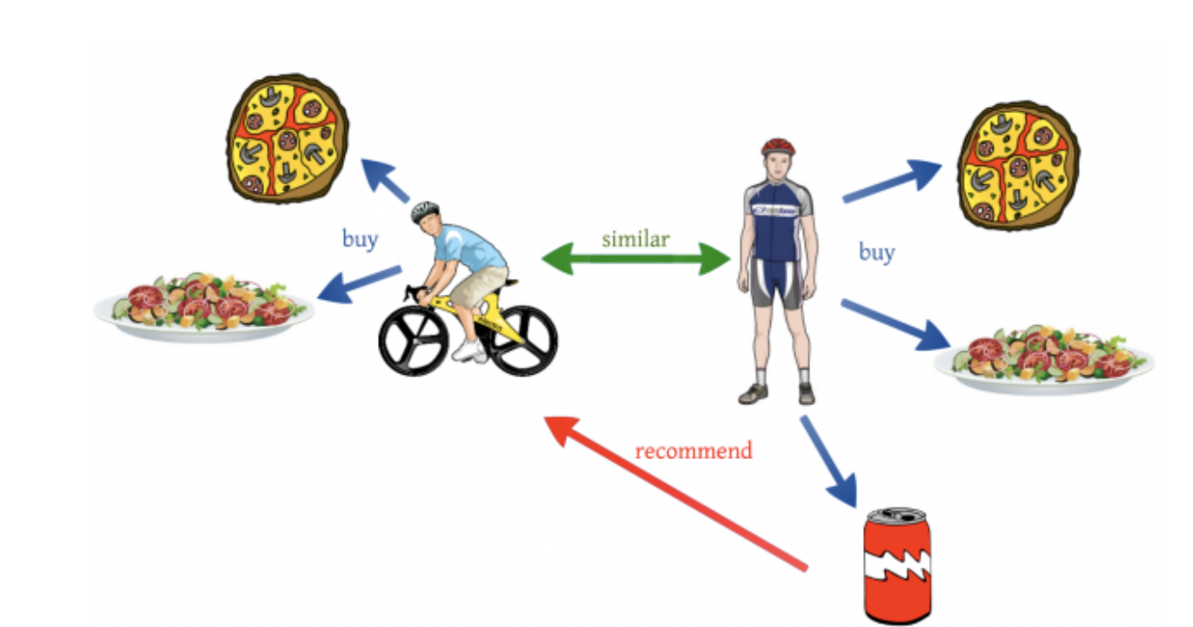
Techniques to recommendation generation

Slide 6
Techniques to recommendation generation
Content Based Systems recommend items similar to those a user has liked (purchased/browsed) in the past.
Advantages:
No need for data on other users.
No cold start problem.
Able to recommend users with unique taste.
Able to recommend new and unpopular items.

Slide 7
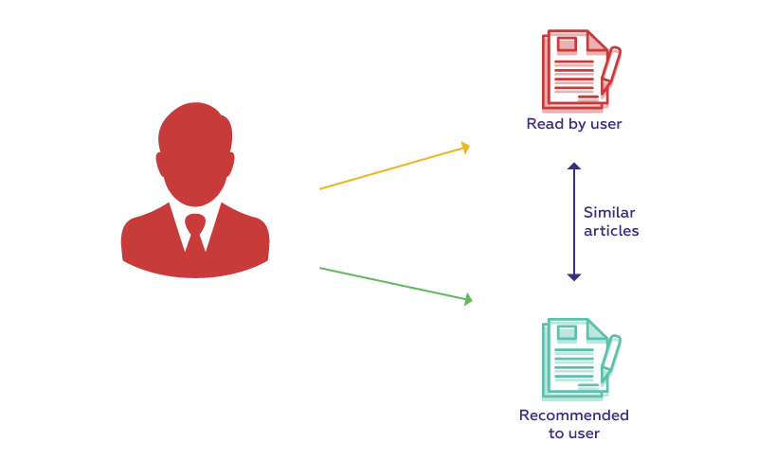
Techniques to recommendation generation

Slide 8


My work
Recommendations using the content based filtering method.
Data:
https://www.kaggle.com/stefanoleone992/imdb-extensive-dataset

Slide 9
My work
Imported necessary libraries and the data.
Took the necessary columns like movie name, movie genre, etc.
Also did some visualization of the data.

Slide 10
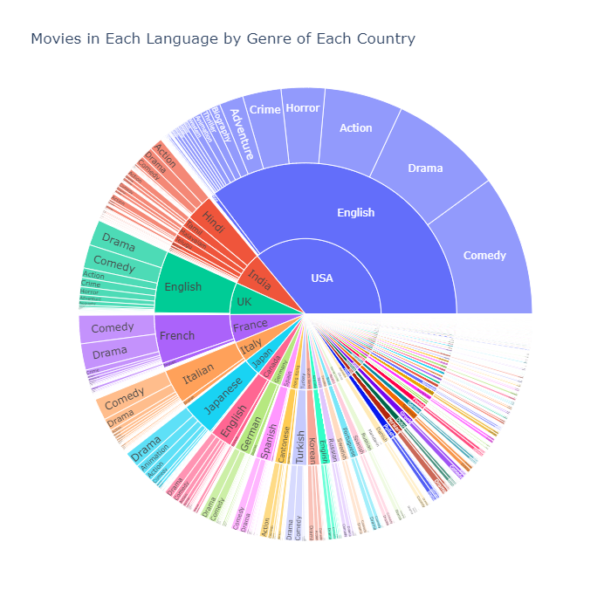
My work

Slide 11
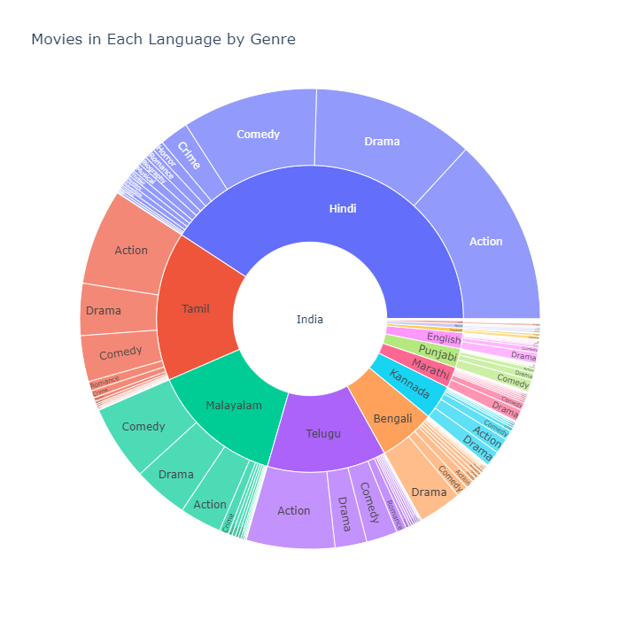
My work
Doing recommendations on Indian movies only.

Slide 12
My work
Removed punctuation from columns.
Discarded stopwords from description column.
text=[word for word in text if word not in stopwords.words('english’)]

Slide 13
My work
Concatenated columns data into a new column by each row.
new_feature=[]
for item in df.itertuples():
new_feature.append(item[2]+' '+item[3]+' '+item[4]+' '+item[5]+' '+item[6])
df['new_feature']=new_feature

Slide 14
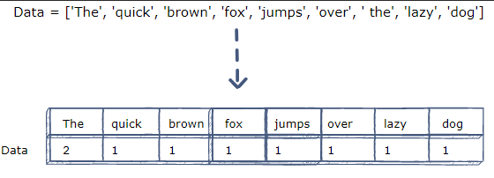
My work
Applied fit_transform() method from CountVectorizer class, creating a matrix of unique words.
cm=CountVectorizer().fit_transform(df['new_feature’])
This word count matrix is of shape
(6189, 32293)

Slide 15
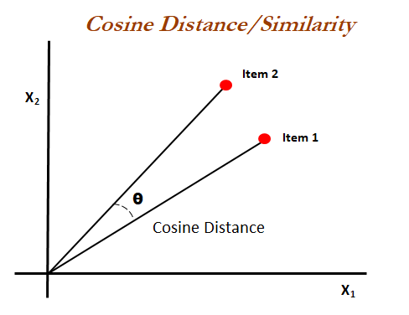
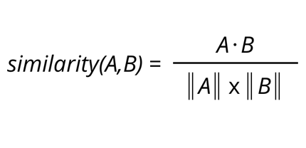
My work
Using cosine distance to measure the similarity.
Cosine distance measures the cosine of the angle between two vectors projected in a multi-dimensional space.

Slide 16
My work
Using the similarity measures and getting recommendations.
def get_recommendation(movie_name):
id_=movies[movies['title']==movie_name]['imdb_title_id'].values[0]
title_id=cs_df_sorted[id_].values
for i in title_id:
print(movies[movies['imdb_title_id']==i]['title'].values[0])

Slide 17
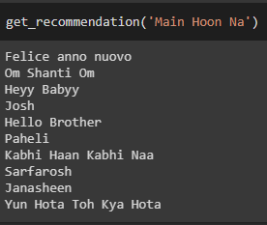
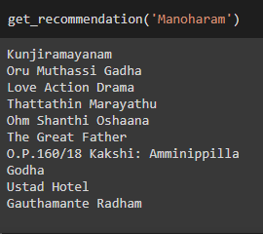
My work
Result section:

Slide 18
My work
Deploying this recommendation engine.
Used Flask library.

Slide 19
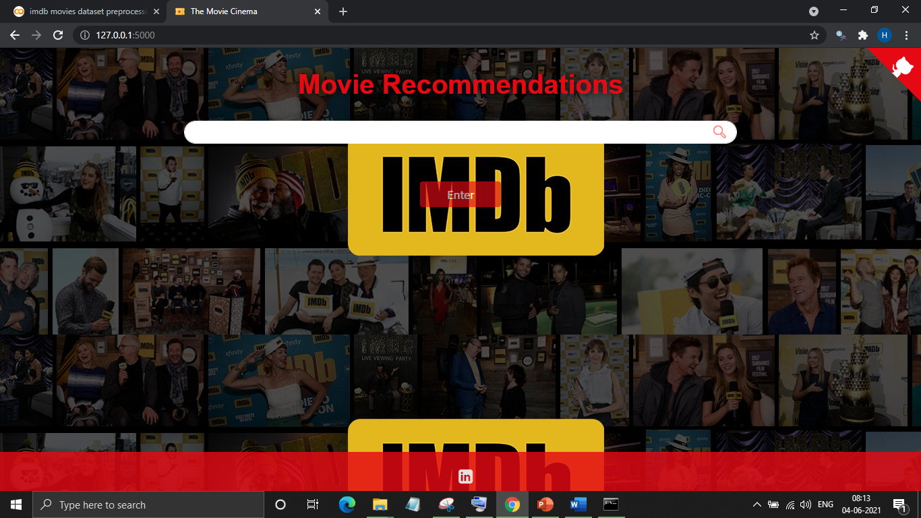
Home page

Slide 20
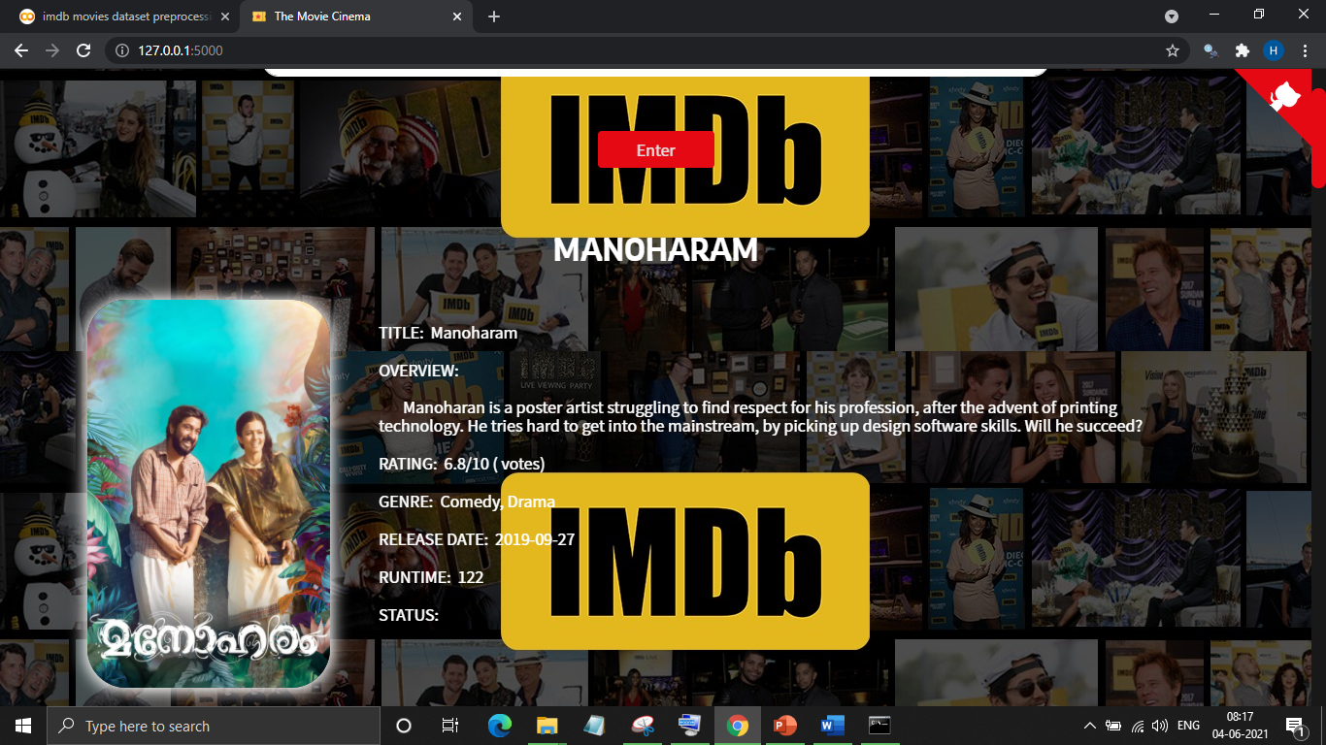
Recommend page

Slide 21
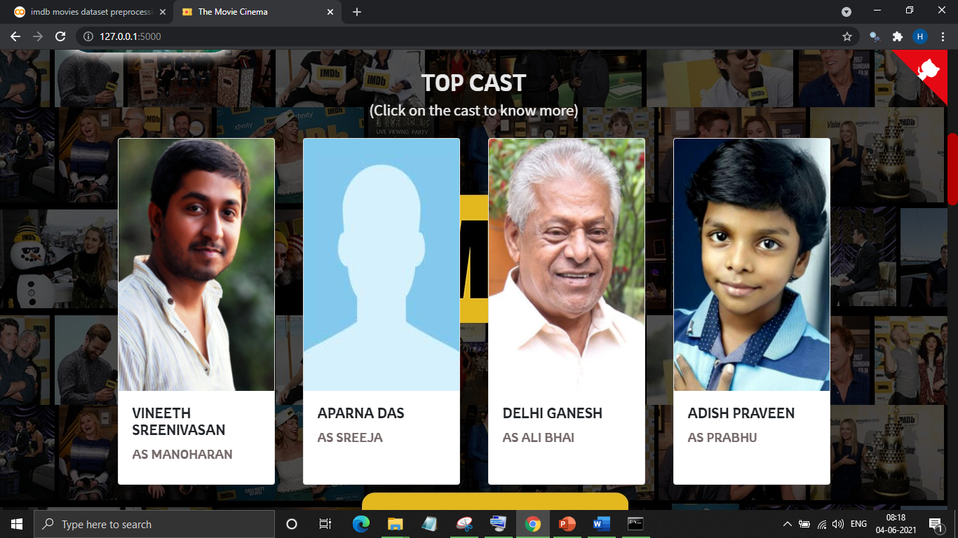
Recommend page

Slide 22
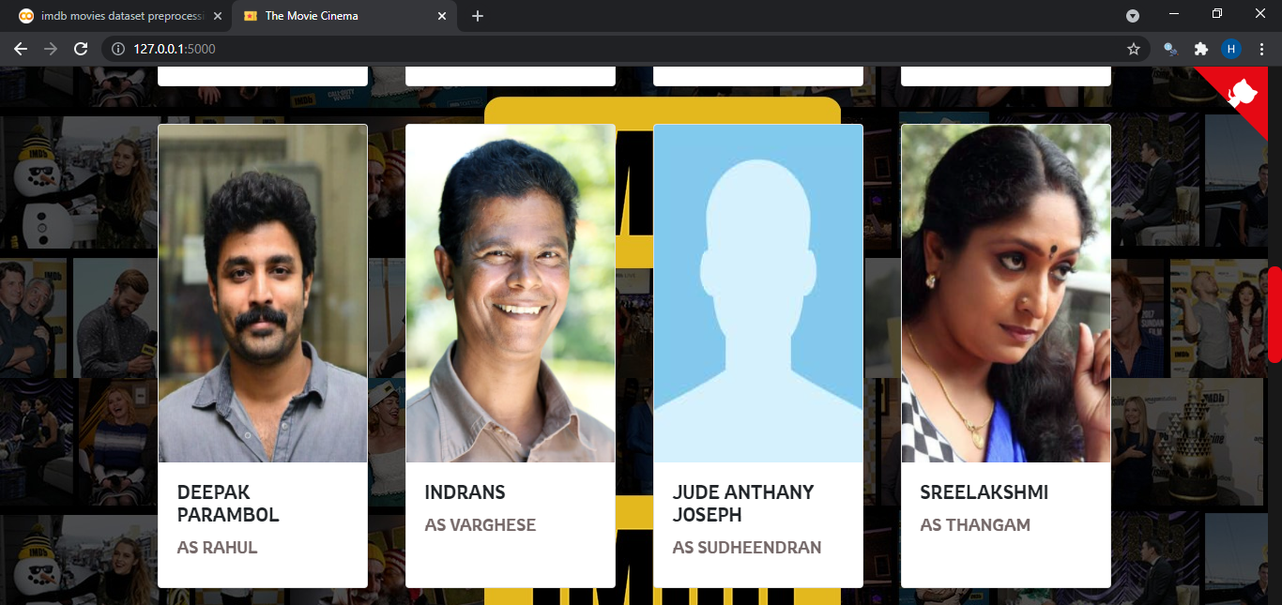
Recommend page

Slide 23
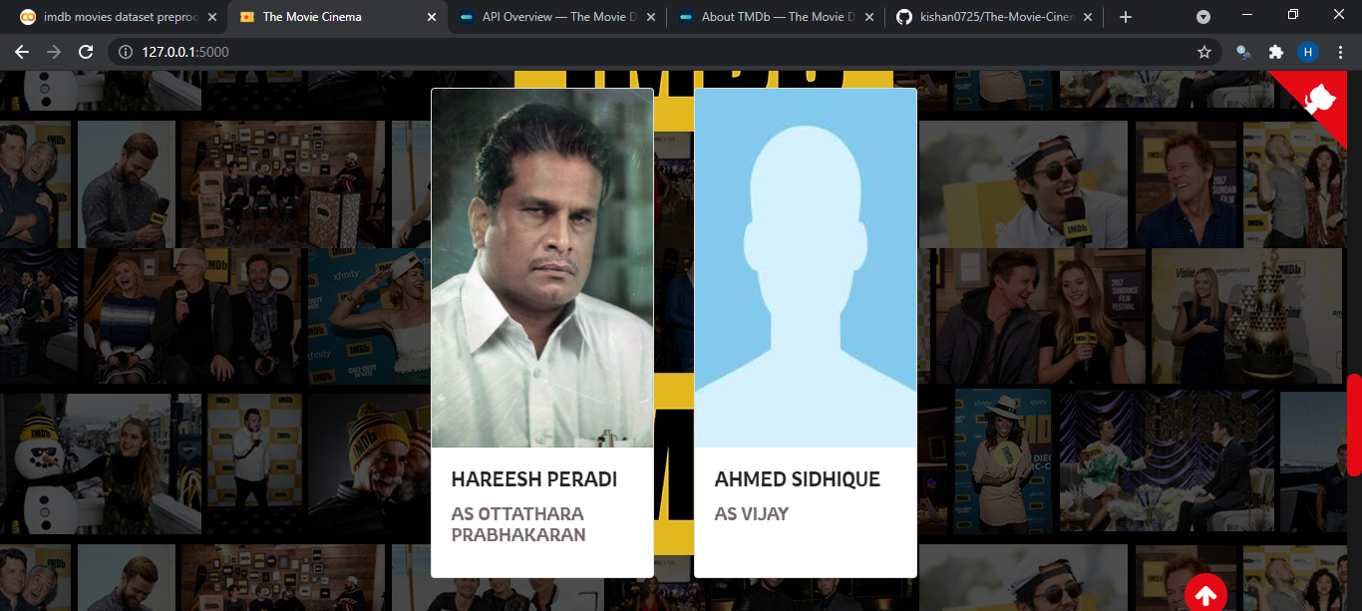
Recommend page

Slide 24
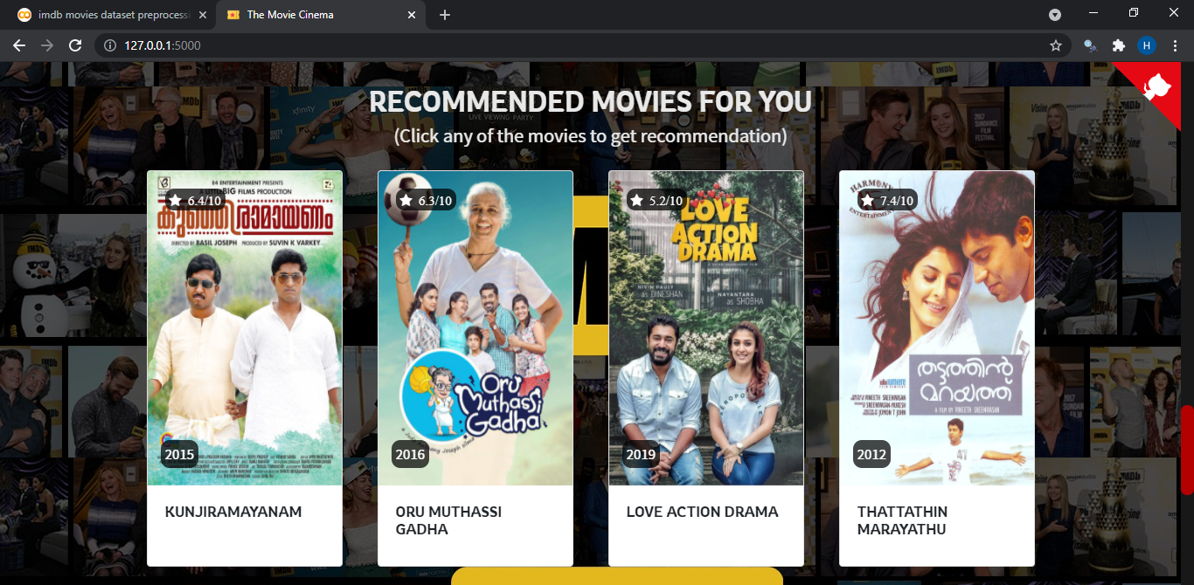
Recommend page

Slide 25
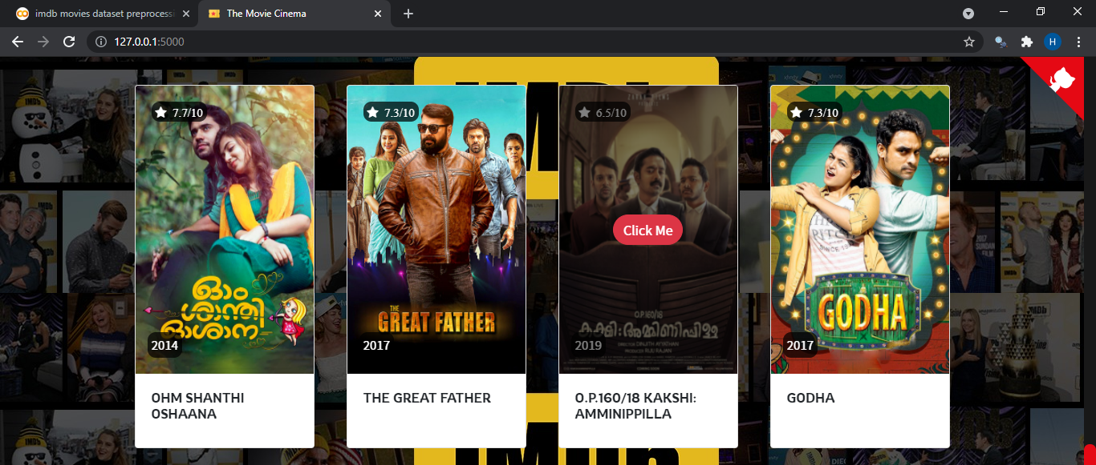
Recommend page

Slide 26
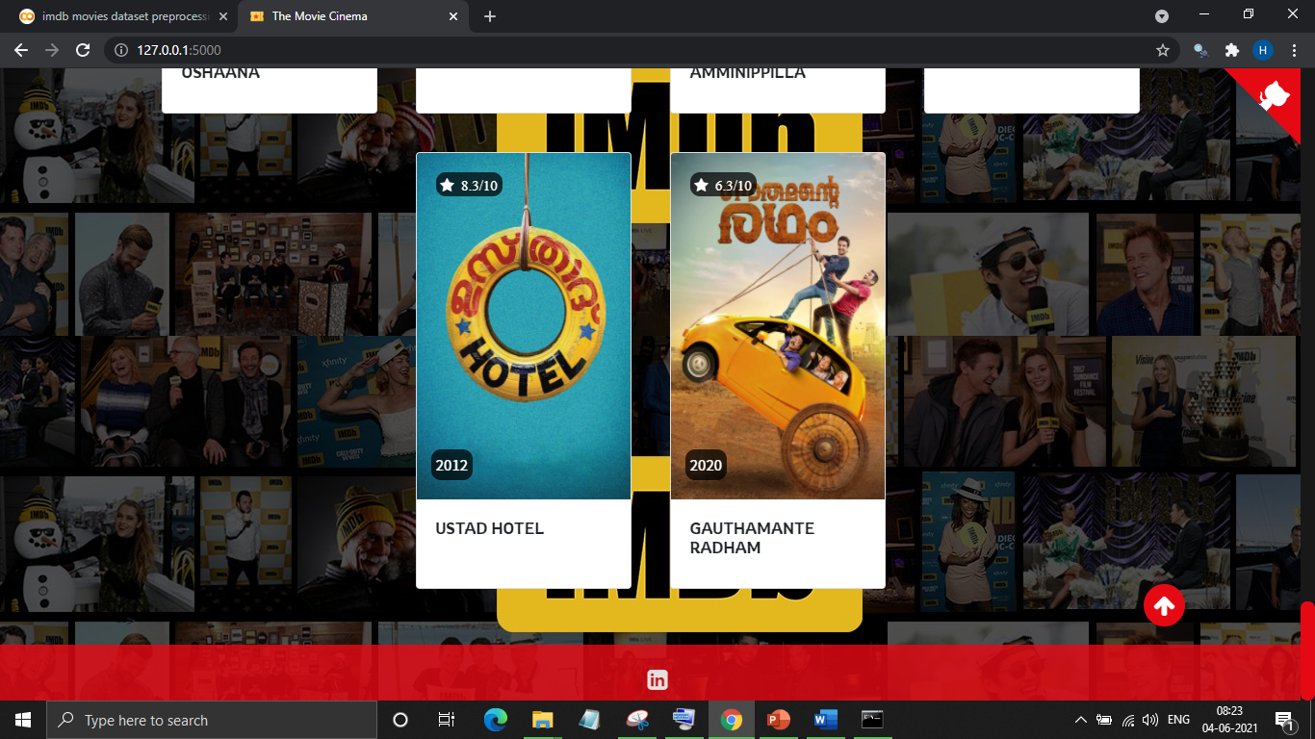
Recommend page

Slide 27
Questions?

Slide 28
thank you.

